Slide 1

Capstone Project Presentation
Title : Online Pizza Ordering System Using Mern Stack
Presented By: R Bhaskar Naik
Guide Name : Abhishek Sharma

Slide 2
Project Overview
Pizza Hub is a web-based application that allows users to browse pizzas, place orders, and track their orders online.
Purpose of the Project
Simplify online food ordering
Provide a smooth user experience
Allow admins to manage pizzas and orders
Key Users
Customers
Admin

Slide 3
Technology Stack
Frontend
React.js
Bootstrap
Redux (State Management)
Backend
Node.js
Express.js
Database
MongoDB

Slide 4
Key Features
User Features
User Registration and Login
Browse pizza menu
Add items to cart
Place orders
Admin Features
Manage menu items
Manage users
Update order status
View dashboard statistics

Slide 5
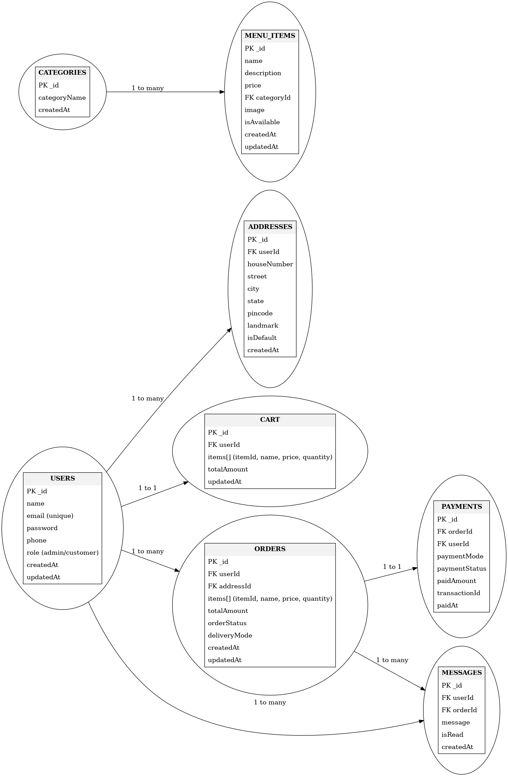
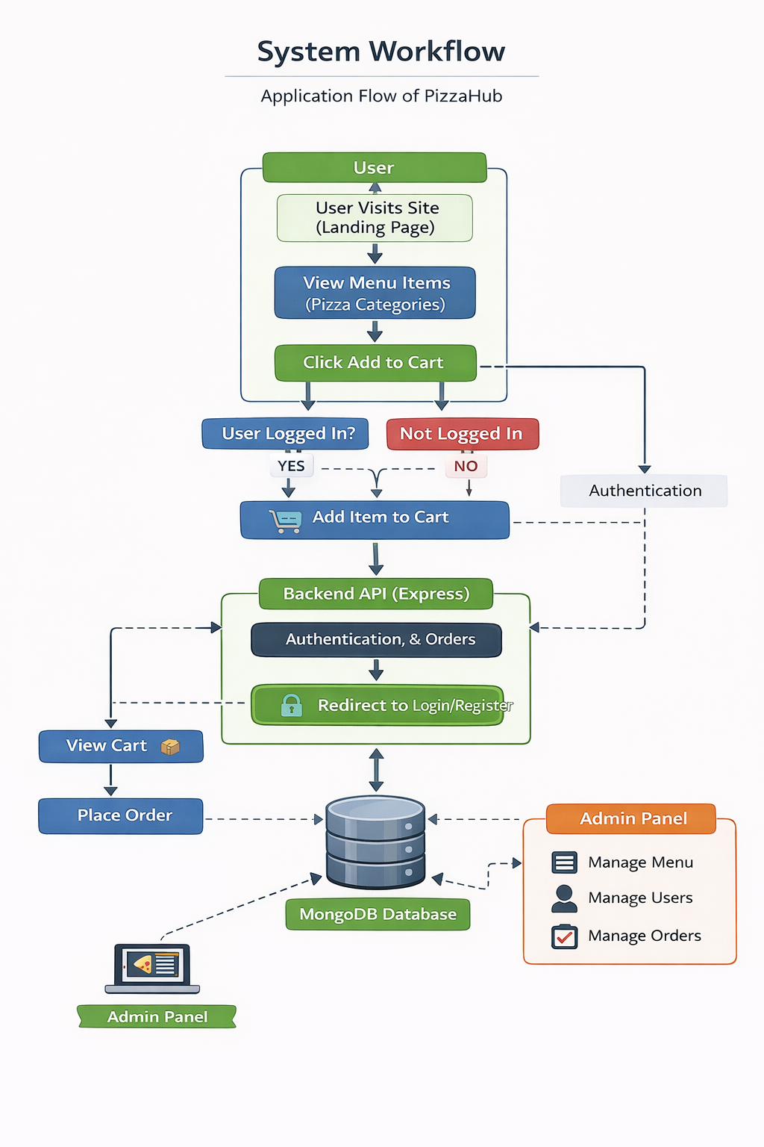
System Workflow And Er Diagram

Slide 6
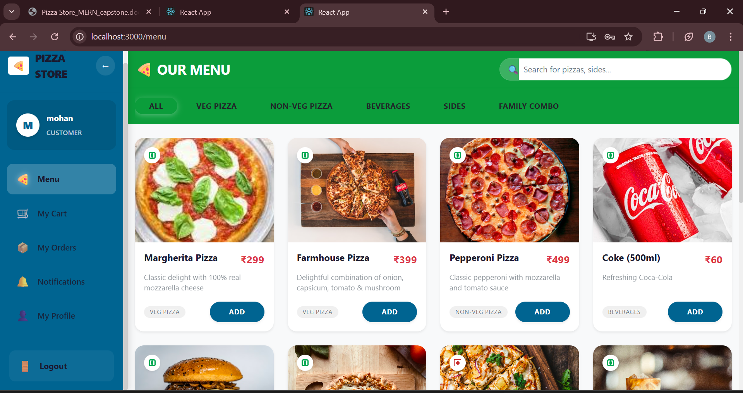
Application Screenshots
User View

Slide 7
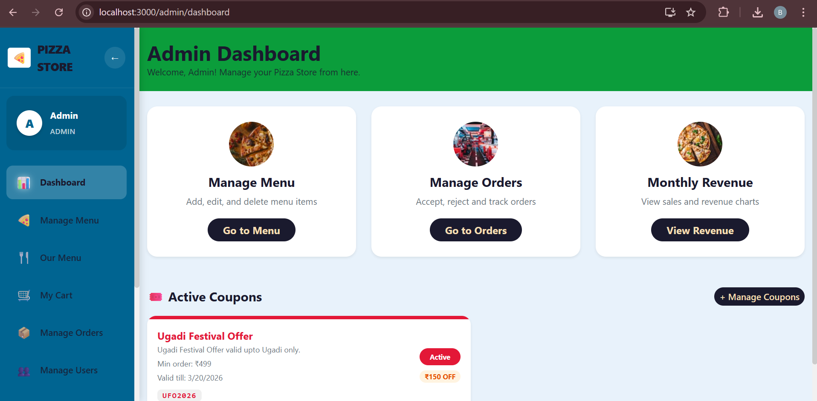
Admin View

Slide 8
Future Improvements
Online Payment Integration Enable secure payments using UPI, cards, and wallets.
Real-Time Order Tracking Allow users to track orders with live status updates.
Mobile Application Support Develop Android & iOS apps for better accessibility.
AI-Based Recommendations Provide personalized suggestions and chatbot support.
Enhanced Security Implement 2FA, secure authentication, and data protection.

Slide 9
Conclusion
Project Outcomes
Successfully built a full-stack pizza ordering system
Implemented secure authentication
Developed admin and user modules
Improved skills in MERN stack development

